Slide 1


Gaming Case Studies

Slide 2


Rare Studios – Insider Dynamics Program
Business Need
Affirma supports and maintains Rare’s Dynamics instance for their highly popular game, Sea of Thieves. A primary use case Dynamics for Rare is to run their insider community for their most passionate gamers.
Rare had the following needs to expand their Dynamics solution.
Improved data warehouse solution that could consume data from multiple sources and pipelines
Process partner data in a time effective way
What We Did
Designed, executed, and delivered two complex Azure Data Factory solutions for Rare's data warehouse requirement.
Update Dynamics objects, workflows, and permissions to allow data integration with the new data warehouse.

Slide 3

Turn 10 - Dynamics 365
Front end integration
Player
Updates
Marketing
CPM
Event announcements
Customer Voice
Surveys
Implementation
Data management
Newsletter Embedded
Front end Embedded
Player
Title Metadata
Opt-in
Survey submissions
Coding
Newsletter
NGP/DSR
Topic based Segmentation
Optout
Engagement Overview​
Turn 10 identified the need for a unified platform to engage and manage Player data and communications for their popular game Forza.
Affirma developed custom extensions for Dynamics core elements and used front-end integrations to capture/update player data.
Together with Turn 10, we regularly release community campaigns, including for their insiders program which launched in 2024
Dynamics CRM

Slide 4
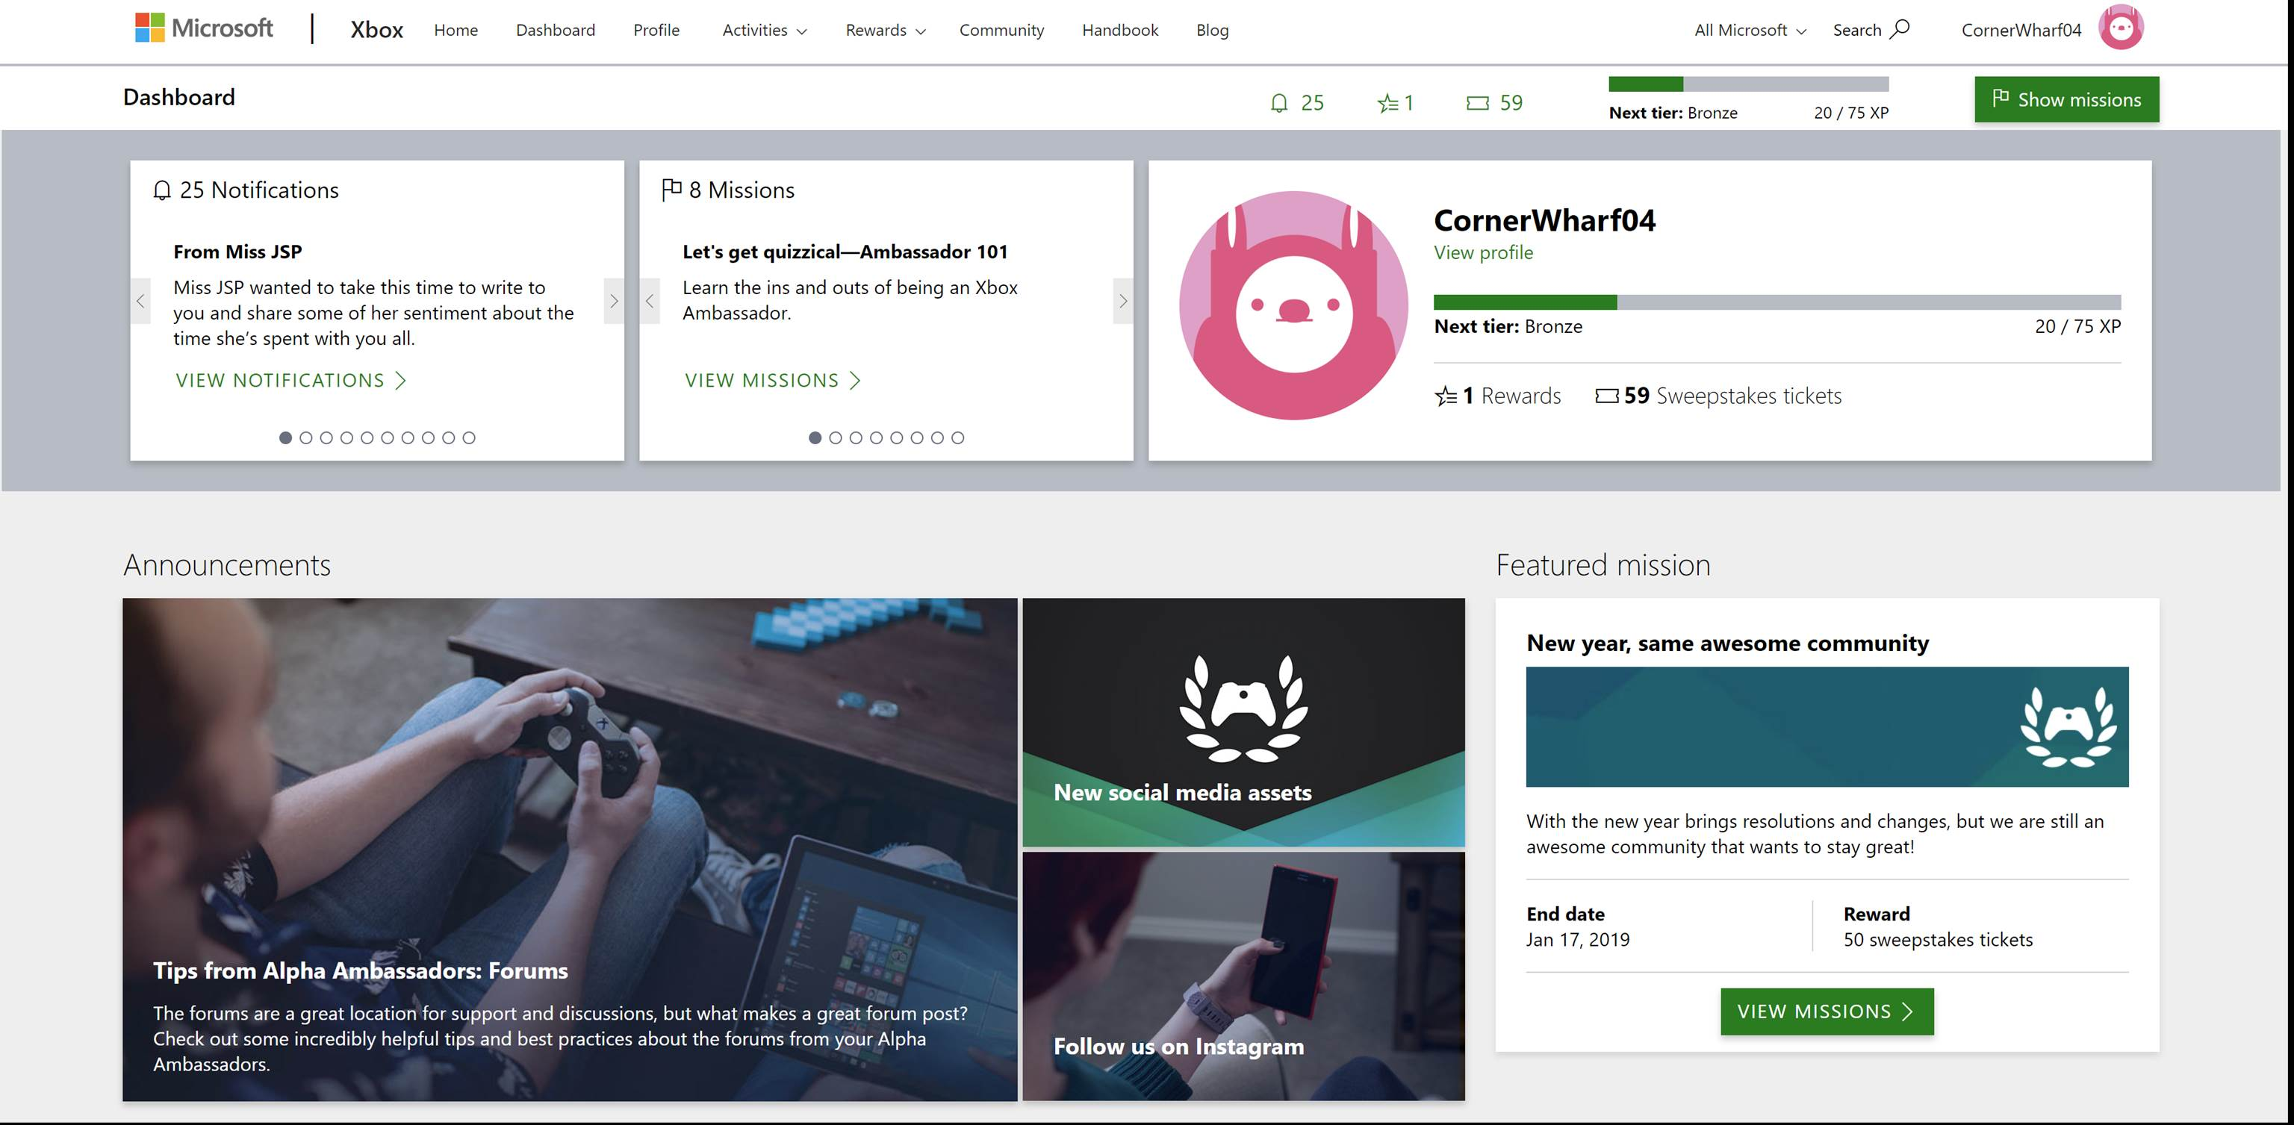
Xbox Ambassadors
Goal
The Xbox Ambassadors are a community of gamers working together to help the broader gaming community base resolve issues and answer questions. They came to Affirma initially to set up a team that would reduce call center costs. At the time, a significant amount service requests were going directly to the Microsoft call center.
Deliverables
Put together a development team dedicated to XA, along with content/social media manager, and community managers.
Built and maintains the Xbox Ambassador web application and Azure Service Fabric backend platform. We provide general .NET and Azure services to support all platform processes and activities
Created a dashboard for the Xbox Ambassadors with leaderboard KPIs.
Help run seasonal badge driven contests per quarter to drive Ambassador participation and service levels
Result
Reduction in call center cost through online gaming community
Helped establish a vibrant and active community of enthusiastic Xbox Ambassadors
Enriched online self-help services to solve issues online, in forums and on social media platforms

Slide 5


Xbox – Dynamics Customer Support
Business Need
Microsoft’s Xbox Customer Support team came to Affirma for help improving their customer service and case escalation processes. They had many siloed systems in place for triaging and escalating support cases placed by end users of Xbox. This resulted in fragmented communications, and almost no process automation or reporting.
What We Did
Affirma gathered requirements and recommended significant process improvements.
Our team then designed a solution on Dynamics 365 to support the entire lifecycle of support cases. This included intake, triage, communication, resolution and reporting.
Dynamics 365 was integrated with another Customer Support platform at Microsoft which is built on Azure Dev Ops (ADO).
Affirma performed extensive quality assurance on the Dynamics 365 solution across functionality and user roles. This included test planning, full QA, bug fixing, UAT, production testing, and ongoing support post-deployment for minor iterations.
Affirma continues to engage with the XBOX to enhance functionality and reporting as needed.

Slide 6
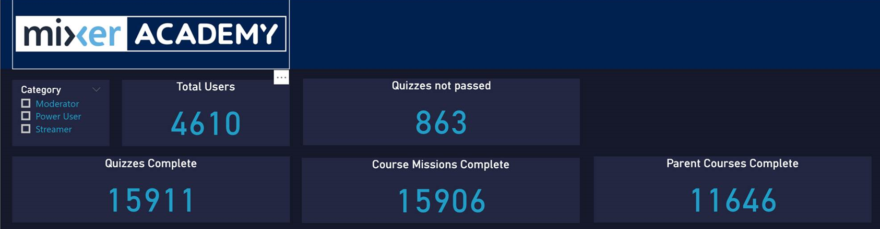
Mixer Academy
Goal
Mixer Academy was created to equip content producers with the latest tips and tools of trade. The Academy aims to provide learning courses to develop skill sets and make power users, moderators and streamers better at what they do.
Deliverables
Affirma built and maintains the Mixer Academy web application and Azure Service Fabric backend platform
Provides several learning courses on subjects such as streaming, how to produce a quality video, sponsorships, lighting etc.
Tracks and reports on engagement and activity levels
Result
Within 24 hours of launch, more than 4,000 users signed up and nearly 16K quizzes were completed, exceeding engagement targets.
Affirma continues to maintain and run the web application and backend platform

